Slide 1
WEEK 8
Advanced VAPT
Name : B SAI AMULYA GOUD
SIN : DG/SEPTEMBER/CYBER/179

Slide 2
OBJECTIVES
  Attack Surface Mapping: Identify login forms, input fields, APIs, endpoints, and application workflows.
  Advanced Vulnerability Testing: Investigate business logic flaws, parameter tampering, IDOR, and session management weaknesses.
  Attack Chain Creation: Combine verified vulnerabilities into a step-by-step attack scenario to demonstrate potential security impact.
  Burp Suite Exploitation: Use Proxy and Repeater to intercept, modify, and replay HTTP requests and analyze server responses.
  Proof of Concept (POC): Collect screenshots and request-response evidence to demonstrate each confirmed vulnerability and attack-chain step.
  Risk and Impact Analysis: Evaluate potential data exposure, account compromise, privilege escalation, and business impact.
  Remediation Strategy: Recommend security fixes for individual vulnerabilities and the complete attack chain.
  Professional Reporting: Prepare a detailed VAPT report and presentation documenting the methodology, findings, evidence, impact, and recommendations

Slide 3
Attack Surface Mapping
Observed endpoint / path | Observed method or input | Purpose / notes
/login.php | GET/POST visible | Login interface.
/security.php | GET/POST visible | DVWA security configuration.
/vulnerabilities/sqli/ | POST confirmed | id and Submit parameters captured.
/vulnerabilities/sqli_blind/ | GET/POST visible | Separate blind SQLi module; not the same endpoint.
/vulnerabilities/brute/ | Path visible | Login-testing module; request details pending.
/vulnerabilities/csrf/ | GET visible | CSRF module; testing not documented yet.
/vulnerabilities/fi/ | GET with page parameter visible | File Inclusion input surface only.
/vulnerabilities/weak_id/ | Path visible | Token behaviour not yet verified.
/vulnerabilities/xss_r/ | GET with name parameter visible | Reflected XSS module; Week 8 result not documented here.
/vulnerabilities/xss_s/ | Path visible | Stored XSS module; Week 8 result not documented here.

Slide 4
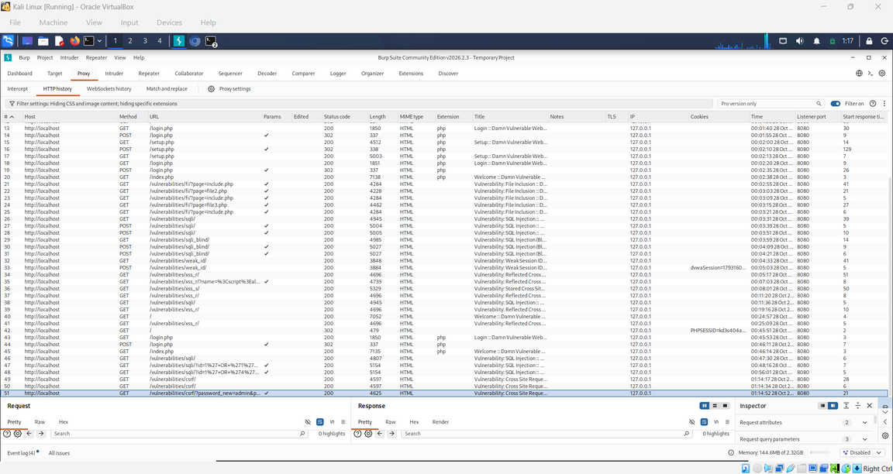
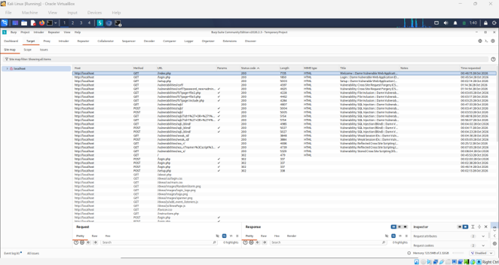
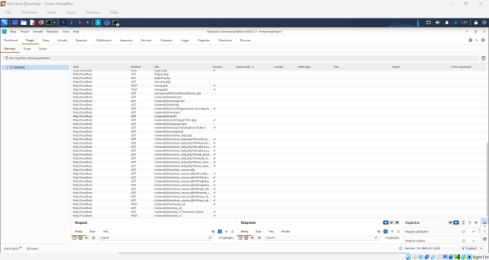

Slide 5
SQL Injection Endpoint: Request Analysis
Property | Observed value
HTTP method | POST
Endpoint | /vulnerabilities/sqli/
Request body parameters | id=1; Submit=Submit
Response status | 200 OK
Interpretation | Confirms request processing; does not alone prove SQL injection.

Slide 6
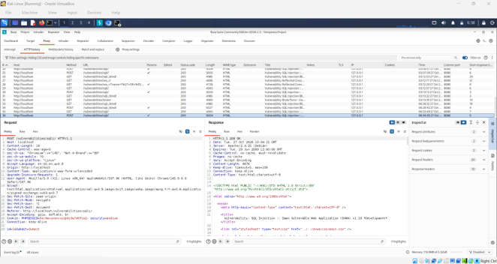
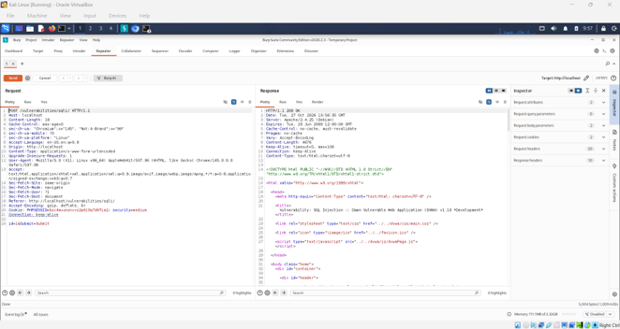

Slide 7
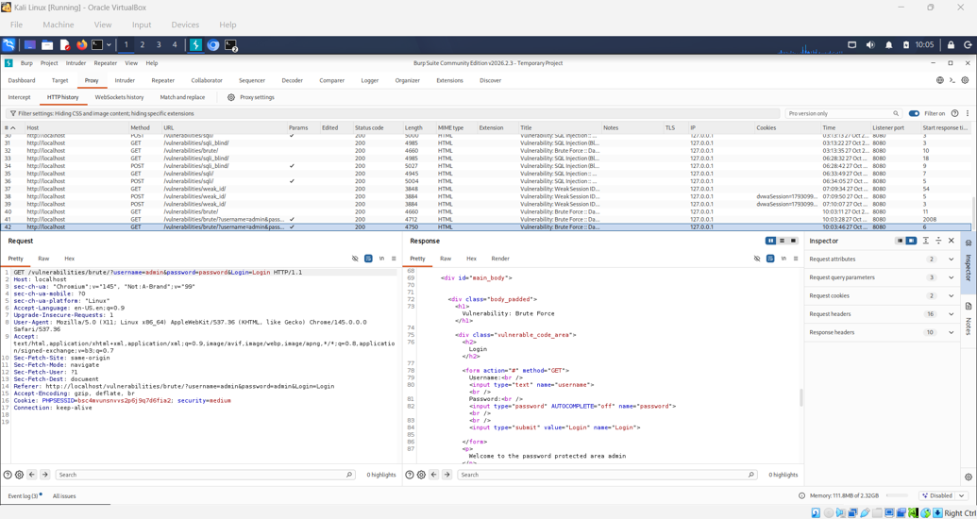
Additional Module Review
Brute Force

Slide 8
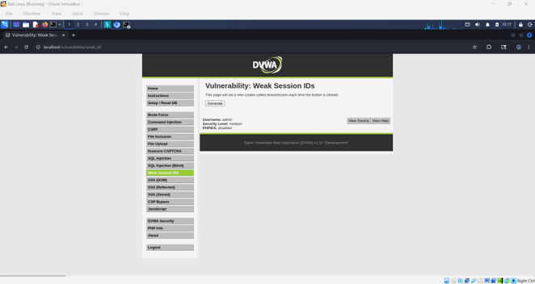
Weak Session IDs

Slide 9
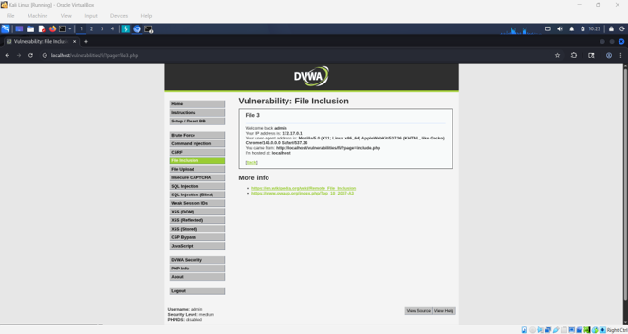
File Inclusion

Slide 10
Logic-Based Testing and Attack Chain
Stage | Current status | Evidence needed
Identify reachable modules | Observed | Site map screenshot.
Inspect SQLi request structure | Observed | HTTP history showing POST path and parameters.
Verify a security weakness | Observed | Controlled request/response comparison with repeatable result.
Link findings into a chain | Observed | Evidence one verified issue enables the next.
Demonstrate impact | Observed | Safe, local-lab proof of the claimed impact.

Slide 11
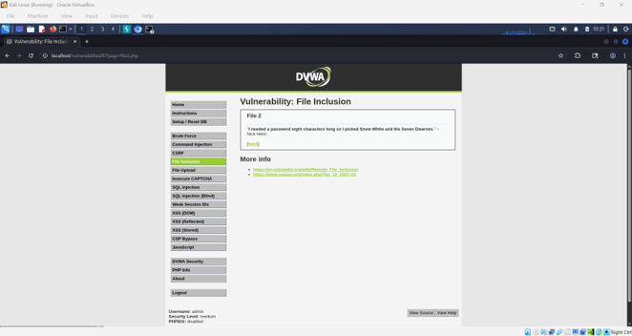
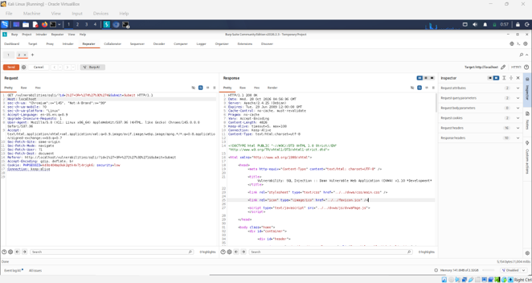
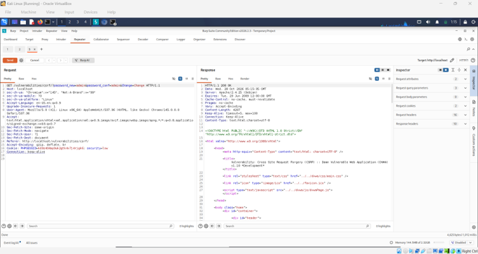

Slide 12
RISK SUMMARY
Finding / observation | Status | Potential concern | Recommended control
DVWA endpoints mapped | Confirmed observation | Unnecessary or poorly protected routes expand attack surface. | Remove unused routes; apply authentication and authorization.
SQLi POST request captured | Request confirmed; vulnerability not yet proven by this request alone | If unsafe SQL is verified, database data could be exposed or changed. | Use prepared statements and server-side type validation.
File Inclusion page parameter | Attack surface identified only | Weak path validation may allow unintended file inclusion. | Use a strict server-side allowlist.
Weak Session IDs path | Module identified; token weakness not verified | Predictable tokens may risk unauthorized access if confirmed. | Use cryptographically secure random session identifiers.

Slide 13
Recommended Security Controls
· Use parameterized prepared statements for database queries and validate numeric identifiers server-side.
· Generate session identifiers with a cryptographically secure random source and regenerate them after authentication or privilege changes.
· Use strict server-side allowlists for file inclusion; do not derive arbitrary file paths directly from request parameters.
· Apply authorization checks to sensitive operations and object references.
· Use server-side CSRF token validation for state-changing actions.
· Encode untrusted output according to context to reduce cross-site scripting risk.
· Return generic user-facing errors and store detailed diagnostics in protected logs.
· Keep screenshots, request/response evidence, and conclusions consistent; distinguish confirmed findings from untested possibilities.

Slide 14
CONCLUSION
Photo | Where to capture it | Insert after
1 | Target → Site map; localhost expanded; show all items | Section 3
2 | Proxy → HTTP history showing DVWA requests | Section 4
3 | HTTP history; POST /vulnerabilities/sqli/; request body visible | Section 5
4 | Repeater baseline request/response, after performing it | Section 5
5 | Brute Force request in HTTP history, after capturing one test login | Section 6.1
6 | Weak Session IDs page / your own observation, if tested | Section 6.2
7 | File Inclusion page with normal page parameter, if captured | Section 6.3
8 | Evidence for any later verified attack-chain step | Section 7

Slide 15
Thank You

